Slide 1


APPIUM – An application automation tool
Dr. BabaSaheb Ambedkar Technological University’s
Institute of Petrochemical Engineering
Department of Information Technology
Presented by:- Manish Shashikant Jadhav
Roll no.:- 2201933
PRN No.:- 2030408246006
Under the guidance of
Prof. S. S. Kamble

Slide 2

contents
1.INTRODUCTION
2.WHAT IS APPIUM?
3.INVENTION OF APPIUM
4.TYPES OF APPLICATION
5.WHY CHOOSE APPIUM?
6.APPIUM ARCHITECTURE
7.JSON WIRE PROTOCOL
8.APPIUM ON ANDROID
9.APPIUM ON IOS
10.CONCLUSION

Slide 3

INTRODUCTION
APPIUM - AN APPLICATION AUTOMATION TOOL
This Photo by Unknown Author is licensed under CC BY-SA-NC

Slide 4


INTRODUCTION
Appium was originally developed by Dan Cuellar in the C# programming language. Later Appium was rewritten and maintained in node.js by Sauce Labs. Appium is used as an application Automation Tool.

Slide 5
What is Appium?
APPIUM - AN APPLICATION AUTOMATION TOOL

Slide 6

What is Appium?
Appium is an open source, cross platform for automation testing of native, web and hybrid applications on iOS, Android, and Windows desktop platform. It is currently geared towards providing a seamless automation testing experience.

Slide 7
Invention of appium
APPIUM - AN APPLICATION AUTOMATION TOOL
This Photo by Unknown Author is licensed under CC BY-SA-NC

Slide 8


Invention of appium
Appium was originally developed by Dan Cuellar in 2011 under the name of “iOSAuto”, written in the C# programming language.
The Program was open-sourced in August 2012 using the Apache 2 license.
In January 2013, Sauce Labs agreed to fund Appium’s development and motivated its code to be rewritten using Node.js.

Slide 9
Why choose Appium?
APPIUM - AN APPLICATION AUTOMATION TOOL
This Photo by Unknown Author is licensed under CC BY-SA-NC

Slide 10


Why choose Appium?

Slide 11


Why choose Appium?

Slide 12
Types of applications
APPIUM - AN APPLICATION AUTOMATION TOOL
This Photo by Unknown Author is licensed under CC BY-SA-NC

Slide 13
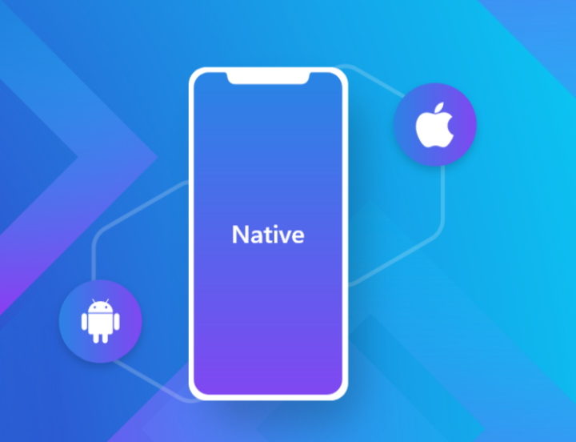
Native application
Native apps live on the device and are accessed through icons on the device home screen. Native apps are installed through an application store (such as Google Play or Apple’s App Store).

Slide 14

web application
These kinds of applications used to be really famous until the concept of native applications came along. Web applications as the name suggests, run on a browser.

Slide 15
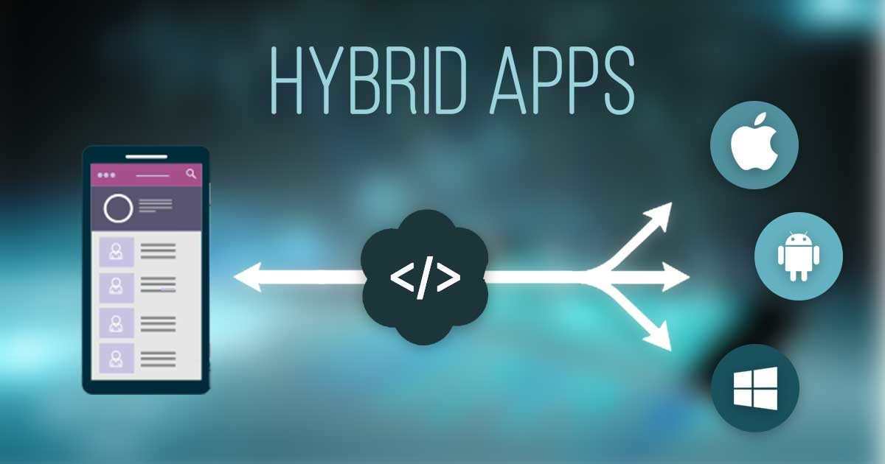
hybrid application
Hybrid apps are part of native apps, part of web apps. Like native apps, they live in an app store and can take advantage of the many device features available. Like web apps, they rely on HTML being rendered in a browser, with the caveat that the browser is embedded within the app.

Slide 16
Appium architecture
APPIUM - AN APPLICATION AUTOMATION TOOL
This Photo by Unknown Author is licensed under CC BY-SA-NC

Slide 17
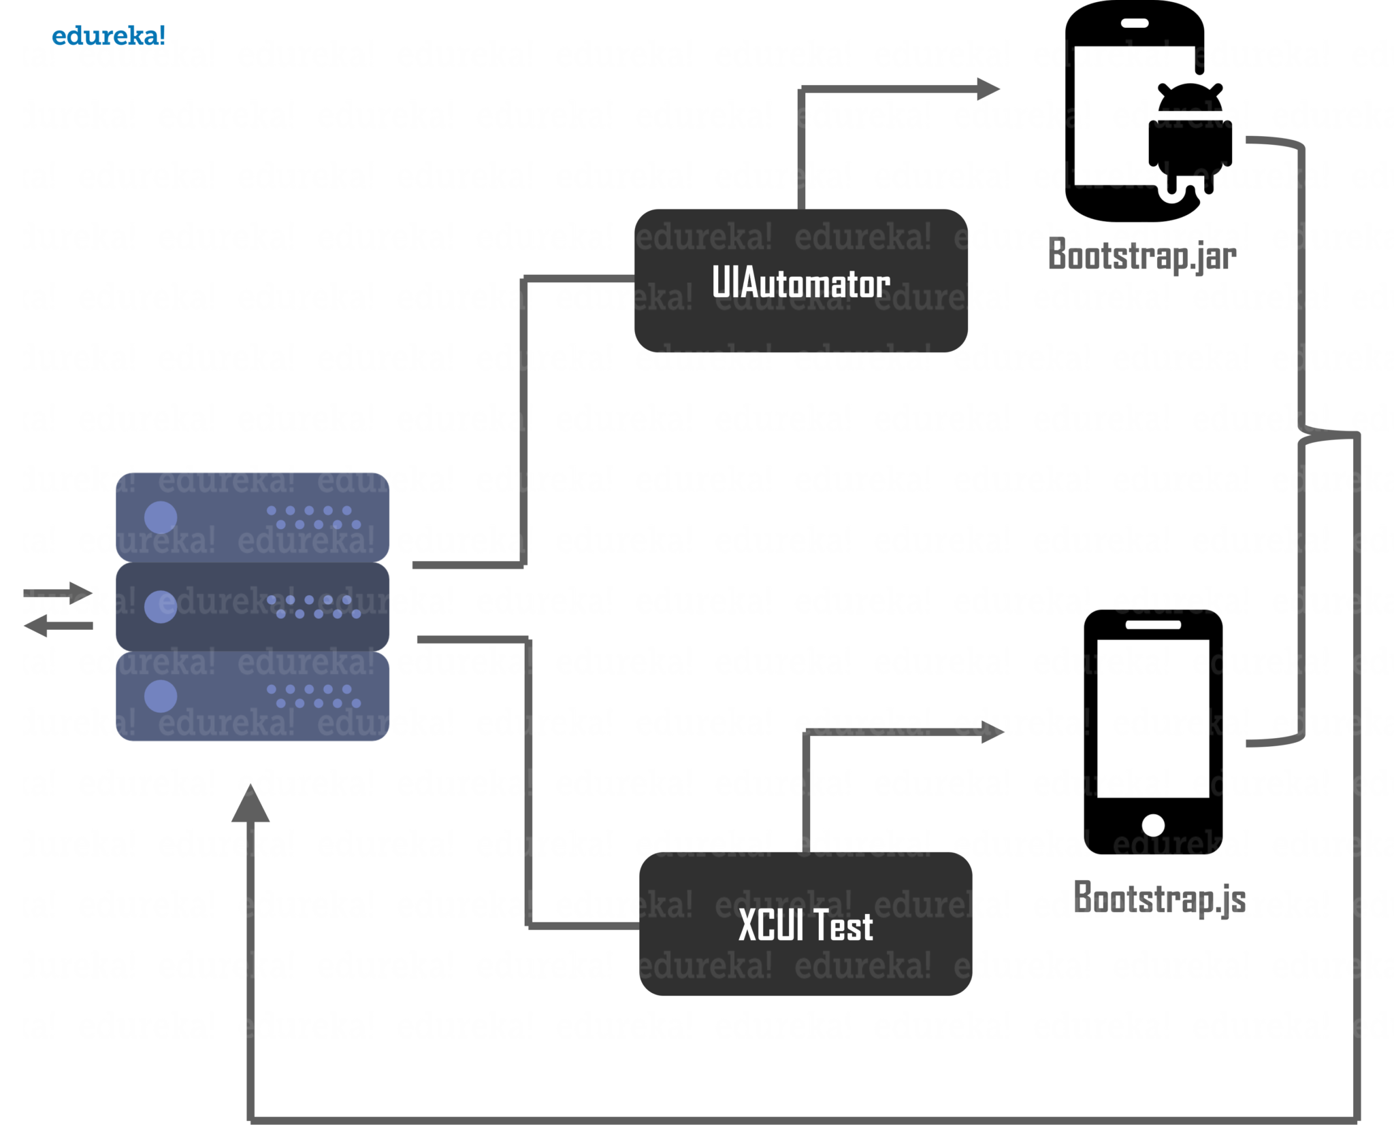
Appium architecture

Slide 18
Json wire protocol
APPIUM - AN APPLICATION AUTOMATION TOOL
This Photo by Unknown Author is licensed under CC BY-SA-NC

Slide 19
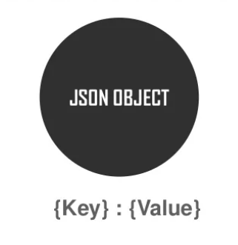
Json wire protocol
JSON is a short form for JavaScript Object Notation, wherein complex data structures are represented.

Slide 20
Appium on android
APPIUM - AN APPLICATION AUTOMATION TOOL
This Photo by Unknown Author is licensed under CC BY-SA-NC

Slide 21
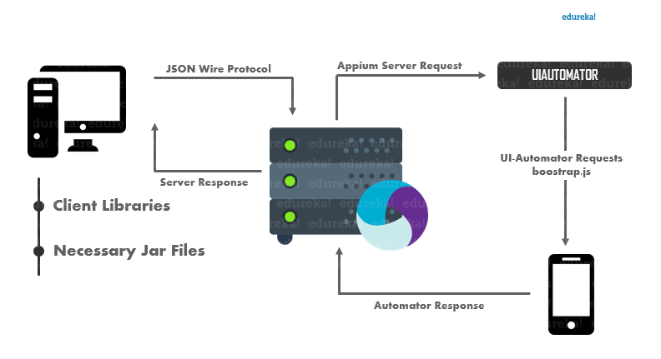
Appium on android
Appium on Android uses the UIAutomator framework for automation. UIAutomator is a framework built by android for automation purposes. So, let’s take a look at the exact way that Appium works on Android.

Slide 22
Appium on ios
APPIUM - AN APPLICATION AUTOMATION TOOL
This Photo by Unknown Author is licensed under CC BY-SA-NC

Slide 23
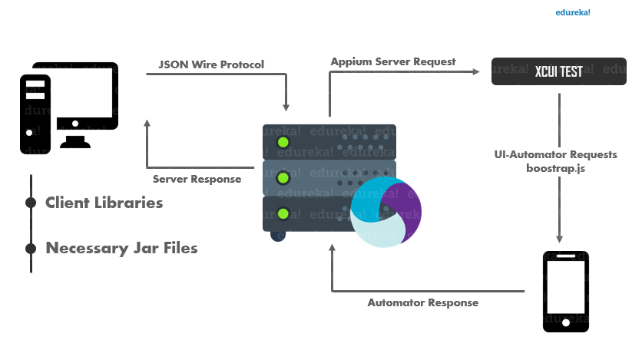
Appium on ios
On an iOS device, Appium uses Apple’s XCUI Test API to interact with the UI elements. XCUITest is the automation framework that ships with Apple’s XCode.

Slide 24
cOnclusion
APPIUM - AN APPLICATION AUTOMATION TOOL
This Photo by Unknown Author is licensed under CC BY-SA-NC

Slide 25
conclusion
Indeed, by this seminar I came to know all the concepts of Appium, and I also understand that we use Appium in different ways for different types of Operating System (OS).
There are multiple options available today when it comes to automation. All the tools available would have their own advantages and disadvantages too. There are lots of benefits offered by Appium for automation testing. A single Appium test can run on multiple devices and OS versions. Creating Appium tests is also easy. But looking at the vast benefits that Appium offers, it is currently the best choice for automation testing.
I hereby also came to know that Manual Testing is so complicated & time consuming. It is very difficult to test the application against multiple users. So Appium is an automated testing tool to test the application in very short time.

Slide 26


